Slide 1

Network Theorems
Chapter
10
Topics Covered in Chapter 10
10-1: Superposition Theorem
10-2: Thevenin’s Theorem
10-3: Thevenizing a Circuit with Two Voltage Sources
10-4: Thevenizing a Bridge Circuit
10-5: Norton’s Theorem
© 2007 The McGraw-Hill Companies, Inc. All rights reserved.

Slide 2
Topics Covered in Chapter 10
10-6: Thevenin-Norton Conversions
10-7: Conversion of Voltage and Current Sources
10-8: Millman’s Theorem
10-9: T or Y and π or Δ Conversions
McGraw-Hill
© 2007 The McGraw-Hill Companies, Inc. All rights reserved.

Slide 3
10-1: Superposition Theorem
  The superposition theorem extends the use of Ohm’s Law to circuits with multiple sources.
  In order to apply the superposition theorem to a network, certain conditions must be met:
    All the components must be linear, meaning that the current is proportional to the applied voltage.

Slide 4
10-1: Superposition Theorem
    All the components must be bilateral, meaning that the current is the same amount for opposite polarities of the source voltage.
    Passive components may be used. These are components such as resistors, capacitors, and inductors, that do not amplify or rectify.
    Active components may not be used. Active components include transistors, semiconductor diodes, and electron tubes. Such components are never bilateral and seldom linear.

Slide 5
10-1: Superposition Theorem
  In a linear, bilateral network that has more than one source, the current or voltage in any part of the network can be found by adding algebraically the effect of each source separately.
  This analysis is done by:
    shorting each voltage source in turn.
    opening each current source in turn.

Slide 6
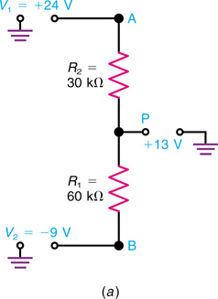
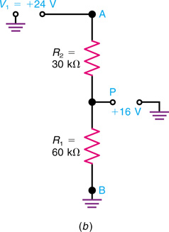
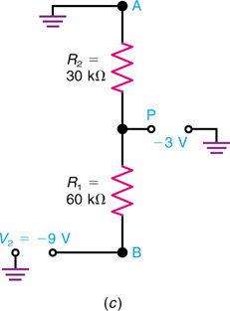
10-1: Superposition Theorem
Fig. 10-1: Superposition theorem applied to a voltage divider with two sources V₁ and V₂. (a) Actual circuit with +13 V from point P to chassis ground. (b) V₁ alone producing +16 V at P. (c) V₂ alone producing −3 V at P.
Copyright © The McGraw-Hill Companies, Inc. Permission required for reproduction or display.

Slide 7
10-1: Superposition Theorem
R₁
R₂
15 V
100 Ω
20 Ω
13 V
V₁
10 Ω
R₃
V₂
R₁
R₂
15 V
100 Ω
20 Ω
V₂ shorted
V₁
10 Ω
R₃
R_{EQ} = 106.7 Ω, I_{T} = 0.141 A and I_{R3} = 0.094 A

Slide 8
10-1: Superposition Theorem (Applied)
R₁
R₂
15 V
100 Ω
20 Ω
13 V
V₁
10 Ω
R₃
V₂
R₁
R₂
100 Ω
20 Ω
13 V
V₁ shorted
V₂
10 Ω
R₃
R_{EQ} = 29.09 Ω, I_{T} = 0.447 A and I_{R3} = 0.406 A

Slide 9
10-1: Superposition Theorem (Applied)
R₁
R₂
15 V
100 Ω
20 Ω
13 V
V₁
V₂
0.094 A
0.406 A
With V₂ shorted
R_{EQ} = 106.7 Ω, I_{T} = 0.141 A and I_{R3} = 0.094 A
With V₁ shorted
R_{EQ} = 29.09 Ω, I_{T} = 0.447 A and I_{R3} = 0.406 A
Adding the currents gives I_{R3} = 0.5 A

Slide 10
10-1: Superposition Method (Check)
R₁
R₂
15 V
100 Ω
20 Ω
13 V
V₁
10 Ω
R₃
V₂
0.5 A
With 0.5 A flowing in R₃, the voltage across R₃ must
be 5 V (Ohm’s Law). The voltage across R₁ must
therefore be 10 volts (KVL) and the voltage across R₂
must be 8 volts (KVL). Solving for the currents in R₁
and R₂ will verify that the solution agrees with KCL.
I_{R1} = 0.1 A and I_{R2} = 0.4 A
I_{R3} = 0.1 A + 0.4 A = 0.5 A

Slide 11
10-2: Thevenin’s Theorem
  Thevenin’s theorem simplifies the process of solving for the unknown values of voltage and current in a network by reducing the network to an equivalent series circuit connected to any pair of network terminals.
  Any network with two open terminals can be replaced by a single voltage source (V_{TH}) and a series resistance (R_{TH}) connected to the open terminals. A component can be removed to produce the open terminals.

Slide 12
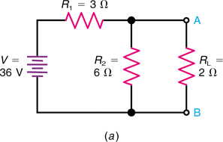
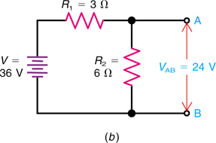
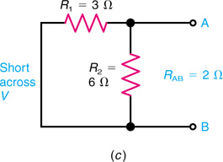
10-2: Thevenin’s Theorem
Fig. 10-3: Application of Thevenin’s theorem. (a) Actual circuit with terminals A and B across R_{L}. (b) Disconnect R_{L} to find that V_{AB} is 24V. (c) Short-circuit V to find that R_{AB} is 2Ω.
Copyright © The McGraw-Hill Companies, Inc. Permission required for reproduction or display.

Slide 13
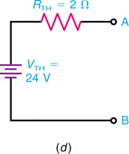
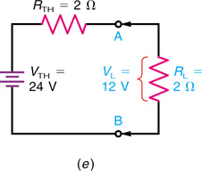
10-2: Thevenin’s Theorem
Fig. 10-3 (d) Thevenin equivalent circuit. (e) Reconnect R_{L} at terminals A and B to find that V_{L} is 12V.
Copyright © The McGraw-Hill Companies, Inc. Permission required for reproduction or display.

Slide 14
10-2: Thevenin’s Theorem
Determining Thevenin Resistance and Voltage
  R_{TH} is determined by shorting the voltage source and calculating the circuit’s total resistance as seen from open terminals A and B.
  V_{TH} is determined by calculating the voltage between open terminals A and B.

Slide 15
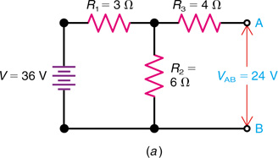
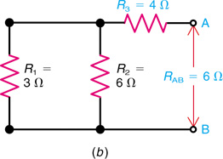
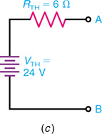
10-2: Thevenin’s Theorem
Note that R₃ does not change the value of V_{AB} produced by the source V, but R₃ does increase the value of R_{TH}.
Fig. 10-4: Thevenizing the circuit of Fig. 10-3 but with a 4-Ω R₃ in series with the A terminal. (a) V_{AB} is still 24V. (b) Now the R_{AB} is 2 + 4 = 6 Ω. (c) Thevenin equivalent circuit.
Copyright © The McGraw-Hill Companies, Inc. Permission required for reproduction or display.

Slide 16
10-3: Thevenizing a Circuit with Two Voltage Sources
The circuit in Figure 10-5 can b solved by Kirchhoff’s laws, but Thevenin’s theorem can be used to find the current I₃ through the middle resistance R₃.
  Mark the terminals A and B across R₃.
  Disconnect R₃.
  To calculate V_{TH}, find V_{AB} across the open terminals

Slide 17
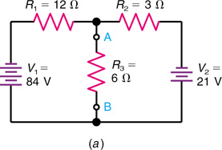
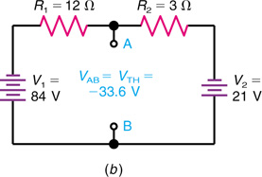
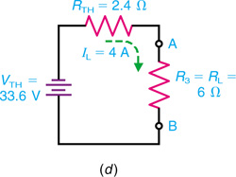
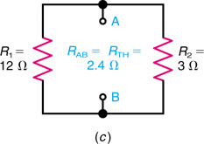
10-3: Thevenizing a Circuit with Two Voltage Sources
Fig. 10-5: Thevenizing a circuit with two voltage sources V₁ and V₂. (a) Original circuit with terminals A and B across the middle resistor R₃. (b) Disconnect R₃ to find that V_{AB} is −33.6V. (c) Short-circuit V₁ and V₂ to find that R_{AB} is 2.4 Ω. (d) Thevenin equivalent with R_{L} reconnected to terminals A and B.
Copyright © The McGraw-Hill Companies, Inc. Permission required for reproduction or display.

Slide 18
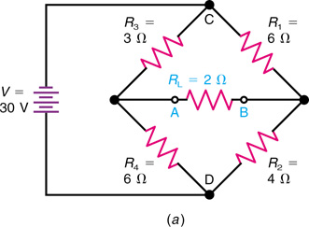
10-4: Thevenizing a Bridge Circuit
A Wheatstone Bridge Can Be Thevenized.
    Problem: Find the voltage drop across R_{L}.
    The bridge is unbalanced and Thevenin’s theorem is a good choice.
    R_{L} will be removed in this procedure making A and B the Thevenin terminals.
Fig. 10-6: Thevenizing a bridge circuit. (a) Original circuit with terminals A and B across middle resistor R_{L}.
Copyright © The McGraw-Hill Companies, Inc. Permission required for reproduction or display.

Slide 19
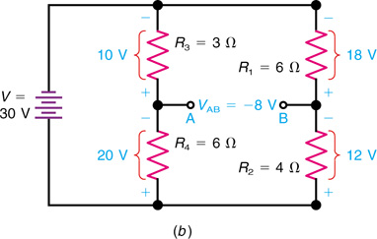
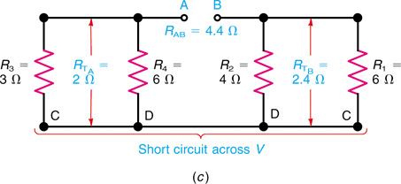
10-4: Thevenizing a Bridge Circuit
R_{AB} = R_{TA} + R_{TB} = 2 + 2.4 = 4.4 Ω
V_{AB} = −20 −(−12) = −8V
Fig. 10-6(b) Disconnect R_{L} to find V_{AB} of −8 V. (c) With source V short-circuited, R_{AB} is 2 + 2.4 = 4.4 Ω.
Copyright © The McGraw-Hill Companies, Inc. Permission required for reproduction or display.

Slide 20
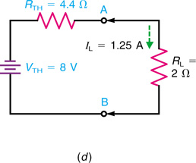
10-4: Thevenizing a Bridge Circuit
Fig. 10-6(d) Thevenin equivalent with R_{L} reconnected to terminals A and B.
Copyright © The McGraw-Hill Companies, Inc. Permission required for reproduction or display.

Slide 21
10-5: Norton’s Theorem
  Norton’s theorem is used to simplify a network in terms of currents instead of voltages.
  It reduces a network to a simple parallel circuit with a current source (comparable to a voltage source).
  Norton’s theorem states that any network with two terminals can be replaced by a single current source and parallel resistance connected across the terminals.
    The two terminals are usually labeled something such as A and B.
    The Norton current is usually labeled I_{N.}
    The Norton resistance is usually labeled R_{N.}

Slide 22
10-5: Norton’s Theorem
Example of a Current Source
  The symbol for a current source is a circle enclosing an arrow that indicates the direction of current flow. The direction must be the same as the current produced by the polarity of the corresponding voltage source (which produces electron flow from the negative terminal).

Slide 23
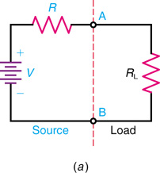
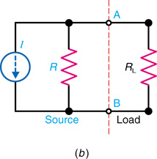
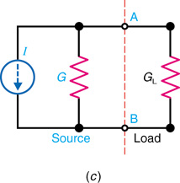
10-5: Norton’s Theorem
Fig. 10-7: General forms for a voltage source or current source connected to a load R_{L} across terminals A and B. (a) Voltage source V with series R. (b) Current source I with parallel R. (c) Current source I with parallel conductance G.
Copyright © The McGraw-Hill Companies, Inc. Permission required for reproduction or display.

Slide 24
10-5: Norton’s Theorem
Example of a Current Source
  In this example, the current I is provided constant with its rating regardless of what may be connected across output terminals A and B. As resistances are added, the current divides according to the rules for parallel branches (inversely to branch resistances but directly with conductances).
  Note that unlike voltage sources, current sources are killed by making them open.

Slide 25
10-5: Norton’s Theorem
Determining Norton Current and Voltage
  I_{N} is determined by calculating the current through a short placed across terminals A and B.
  R_{N} is determined by shorting the voltage source and calculating the circuit’s total resistance as seen from open terminals A and B (same procedure as for R_{TH}).

Slide 26
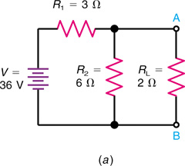
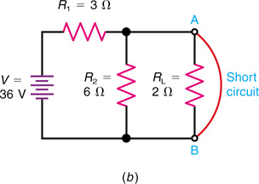
10-5: Norton’s Theorem
A Wheatstone Bridge Can Be Nortonized.
Fig. 10-9: Same circuit as in Fig. 10-3, but solved by Norton’s theorem. (a) Original circuit. (b) Short circuit across terminals A and B.
Copyright © The McGraw-Hill Companies, Inc. Permission required for reproduction or display.

Slide 27
10-5: Norton’s Theorem
The Norton Equivalent Circuit
  Replace R₂ with a short and determine I_{N}.
  Apply the current divider.
  Apply KCL.
  R_{N} = R_{TH}.
  The current source provides 12 A total flow, regardless of what is connected across it. With no load, all of the current will flow in R_{N}. When shorted, all of the current will flow in the short.
    Connect R₂.
    Apply the current divider.
    Use Ohm’s Law.

Slide 28
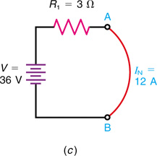
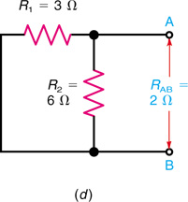
10-5: Norton’s Theorem
Fig. 10-9(c) The short-circuit current I_{N} is 36/3 = 12 A. (d) Open terminals A and B but short-circuit V to find R_{AB} is 2 Ω, the same as R_{TH}.
Copyright © The McGraw-Hill Companies, Inc. Permission required for reproduction or display.

Slide 29
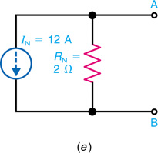
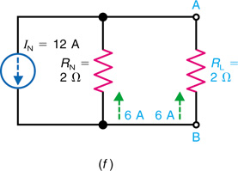
10-5: Norton’s Theorem
I_{L} = I_{N} x R_{N}/R_{N} + R_{L} = 12 x 2/4 = 6 A
Fig. 10-9(e) Norton equivalent circuit. (f) R_{L} reconnected to terminals A and B to find that I_{L} is 6A.
Copyright © The McGraw-Hill Companies, Inc. Permission required for reproduction or display.

Slide 30
10-6: Thevenin-Norton Conversions
Thevenin’s theorem says that any network can be represented by a voltage source and series resistance.
Norton’s theorem says that the same network can be represented by a current source and shunt resistance.
Therefore, it is possible to convert directly from a Thevenin form to a Norton form and vice versa.
Thevenin-Norton conversions are often useful.

Slide 31
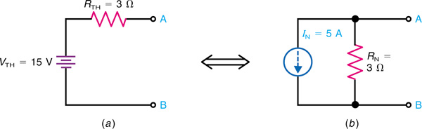
10-6: Thevenin-Norton Conversions
Thevenin
Norton
Fig. 10-11: Thevenin equivalent circuit in (a) corresponds to the Norton equivalent in (b).
Copyright © The McGraw-Hill Companies, Inc. Permission required for reproduction or display.

Slide 32
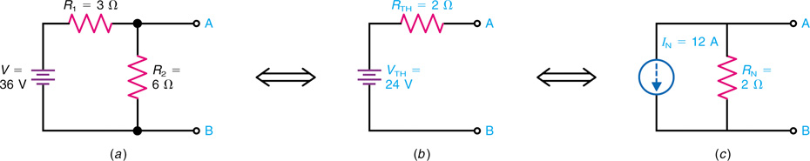
10-6: Thevenin-Norton Conversions
10-6: Thevenin-Norton Conversions
Fig. 10-12: Example of Thevenin-Norton conversions. (a) Original circuit, the same as in Figs. 10-3a and 10-9a. (b) Thevenin equivalent. (c) Norton equivalent.
Copyright © The McGraw-Hill Companies, Inc. Permission required for reproduction or display.

Slide 33
10-7: Conversion of Voltage and Current Sources
  Converting voltage and current sources can simplify circuits, especially those with multiple sources.
  Current sources are easier for parallel connections, where currents can be added or divided.
  Voltage sources are easier for series connections, where voltages can be added or divided.

Slide 34
10-7: Conversion of Voltage and Current Sources
Norton conversion is a specific example of the general principle that any voltage source with its series resistance can be converted to an equivalent current source with the same resistance in parallel.
Conversion of voltage and current sources can often simplify circuits, especially those with two or more sources.
Current sources are easier for parallel connections, where currents can be added or divided.
Voltage sources are easier for series connections, where voltages can be added or divided.

Slide 35
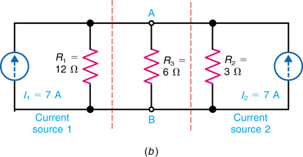
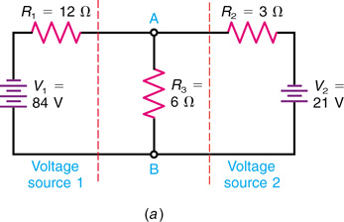
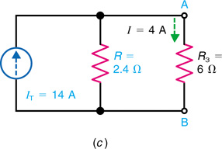
10-7: Conversion of Voltage and Current Sources
Fig. 10-14: Converting two voltage sources in V₁ and V₂ in parallel branches to current sources I₁ and I₂ that can be combined. (a) Original circuit. (b) V₁ and V₂ converted to parallel current sources I₁ and I₂. (c) Equivalent circuit with one combined current source I_{T}.
Copyright © The McGraw-Hill Companies, Inc. Permission required for reproduction or display.

Slide 36
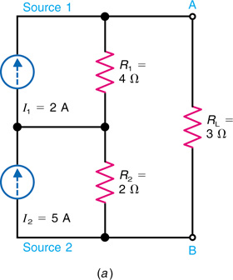
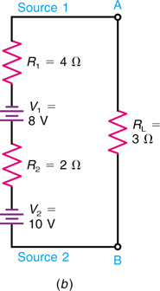
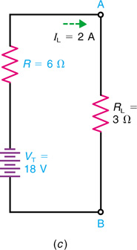
10-7: Conversion of Voltage and Current Sources
Fig. 10-15: Converting two current sources I₁ and I₂ in series to voltage sources V₁ and V₂ that can be combined. (a) Original circuit. (b) I₁ and I₂ converted to series voltage sources V₁ and V₂. (c) Equivalent circuit with one combined voltage source V_{T}.
Copyright © The McGraw-Hill Companies, Inc. Permission required for reproduction or display.

Slide 37
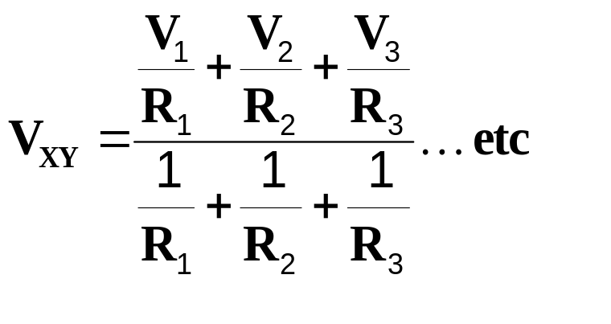
10-8: Millman’s Theorem
  Millman’s theorem provides a shortcut for finding the common voltage across any number of parallel branches with different voltage sources.
  The theorem states that the common voltage across parallel branches with different voltage sources can be determined by:
  This formula converts the voltage sources to current sources and combines the results.

Slide 38
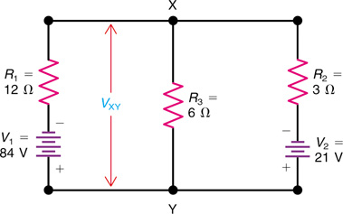
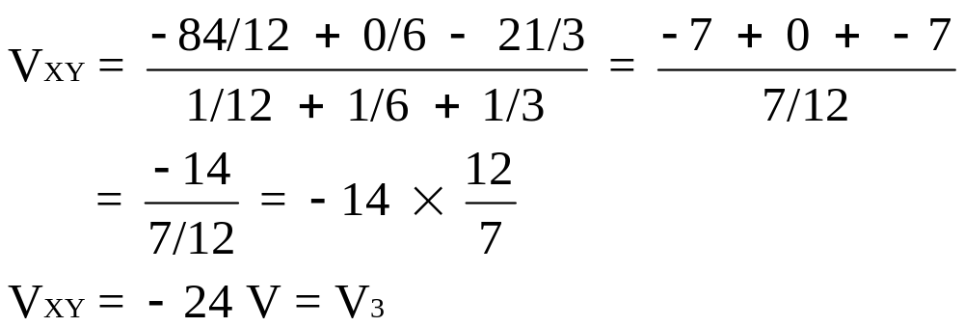
10-8: Millman’s Theorem
Fig. 10-17: The same circuit as in Fig. 9-4 for Kirchhoff’s laws, but shown with parallel branches to calculate V_{XY} by Millman’s theorem.
Copyright © The McGraw-Hill Companies, Inc. Permission required for reproduction or display.

Slide 39
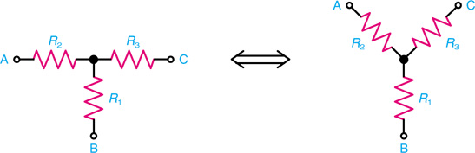
10-9: T or Y and π or Δ Conversions
  Circuits are sometimes called different names according to their shapes.
  This circuit is the same circuit in both diagrams. The one on the left is a T (tee) network; the one on the right is a Y (wye) network.
Fig. 10-19: The form of a T or Y network.
Copyright © The McGraw-Hill Companies, Inc. Permission required for reproduction or display.

Slide 40
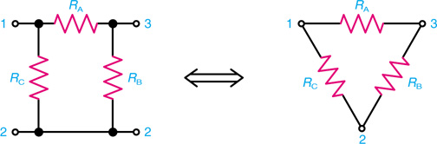
10-9: T or Y and π or Δ Conversions
  Both of the following networks are the same; the one on the left is called a pi (π), and the one on the right is called a delta (Δ), because the forms resemble those Greek characters.
Fig. 10-20: The form of a π or Δ network.
Copyright © The McGraw-Hill Companies, Inc. Permission required for reproduction or display.

Slide 41
10-9: T or Y and π or Δ Conversions
  The Y and Δ forms are different ways to connect three resistors in a passive network.
  When analyzing such networks, it is often useful to convert a Δ to a Y or vice-versa.

Slide 42
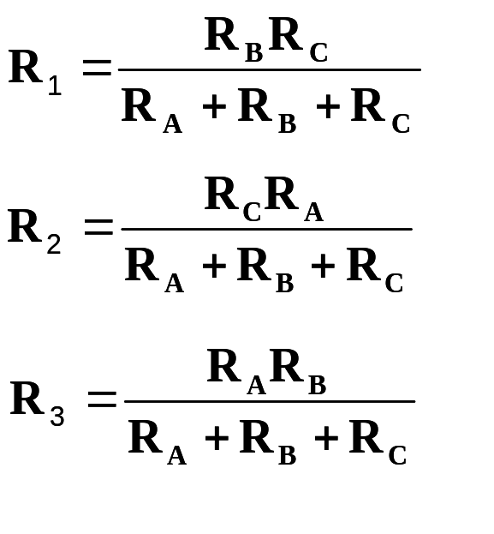
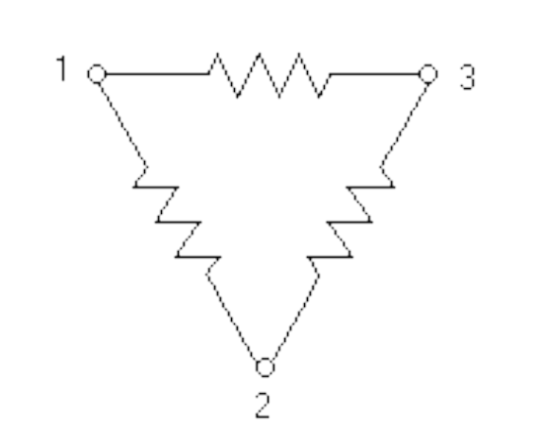
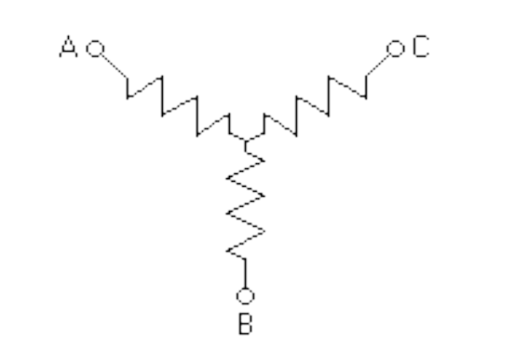
10-9: T or Y and π or Δ Conversions
Delta-to-Wye Conversion
  A delta (Δ) circuit can be converted to a wye (Y) equivalent circuit by applying Kirchhoff’s laws:
  This approach also converts a T to a π network.
R_{A}
R₂
R₃
R_{C}
R_{B}
R₁

Slide 43
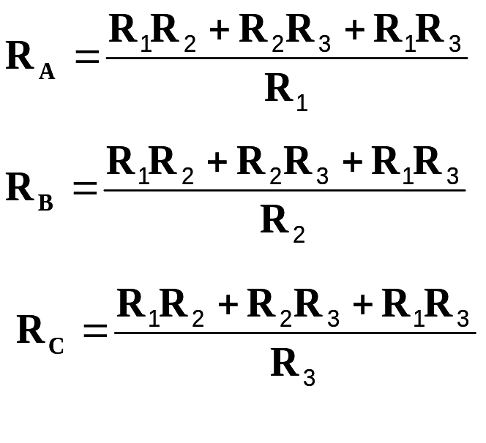
10-9: T or Y and π or Δ Conversions
Wye-to-delta Conversion
  A wye (Y) circuit can be converted to a delta (Δ) equivalent circuit by applying Kirchhoff’s laws:
R_{A}
R₂
R₃
R_{C}
R_{B}
R₁

Slide 44
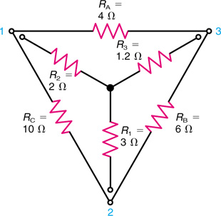
10-9: T or Y and π or Δ Conversions
Useful aid in using formulas:
Place the Y inside the Δ.
Note the Δ has three closed sides and the Y has three open arms.
Note how resistors can be considered opposite each other in the two networks.
Each resistor in an open arm has two adjacent resistors in the closed sides.
Fig. 10-21: Conversion between Y and Δ networks.
Copyright © The McGraw-Hill Companies, Inc. Permission required for reproduction or display.

Slide 45
10-9: T or Y and π or Δ Conversions
In the formulas for the Y-to-Δ conversion, each side of the delta is found by first taking all possible cross products of the arms of the wye, using two arms at a time. (There are three such cross products.)
The sum of the three cross products is then divided by the opposite arm to find the value of each side of the delta.
Note that the numerator remains the same, the sum of the three cross products.
Each side of the delta is calculated by dividing this sum by the opposite arm.

Slide 46
10-9: T or Y and π or Δ Conversions
For the Δ-to-Y conversion, each arm of the wye is found by taking the product of the two adjacent sides in the delta and dividing by the sum of the three sides of the delta.
The product of the two adjacent resistors excludes the opposite resistor.
The denominator for the sum of the three sides remains the same in the three formulas.
Each arm is calculated by dividing the sum into each cross product.

Slide 47
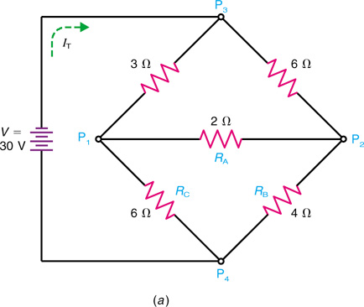
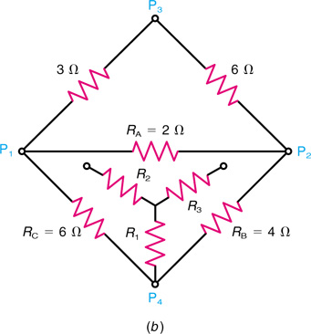
10-9: T or Y and π or Δ Conversions
A Wheatstone Bridge Can Be Simplified.
The total current I_{T} from the battery is desired. Therefore, total resistance R_{T} must be found.
Fig. 10-22: Solving a bridge circuit by Δ-to-Y conversion. (a) Original circuit. (b) How the Y of R₁R₂R₃ corresponds to the Δ of R_{A}R_{B}R_{C}.
Copyright © The McGraw-Hill Companies, Inc. Permission required for reproduction or display.

Slide 48
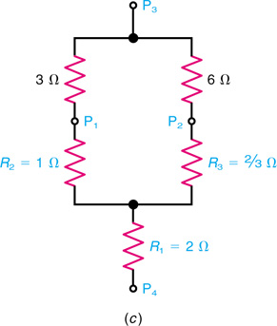
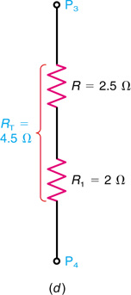
10-9: T or Y and π or Δ Conversions
R_{T} = R + R₁ = 2.5 + 2 = 4.5 Ω
Fig. 10-22 (c) The Y substituted for the Δ network. The result is a series-parallel circuit with the same R_{T} as the original bridge circuit. (d) R_{T} is 4.5Ω between points P₃ and P₄.
Copyright © The McGraw-Hill Companies, Inc. Permission required for reproduction or display.

